Slide 1
Wine Quality Analysis and Prediction using R

Slide 2




The Squad
Sharan Jotwani
Vignesh Sriram
Anooj Kinagi
Omkar Ahir

Slide 3
Motivation
Cost of the wine is determined by a wine taster.
High probability of it being biased
Quality by chemical components?
Taster + Chemical components = UNBIASED?

Slide 4
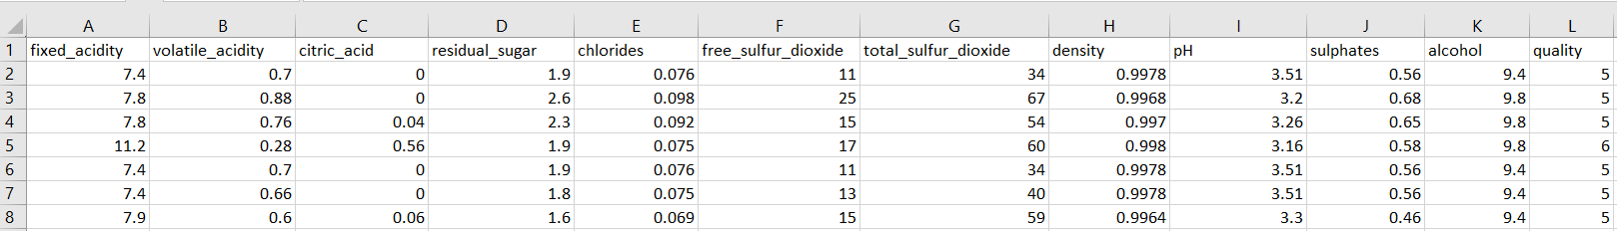
White Wine Dataset
Dataset consists of 12 features and 4899 observations.
The 11 features are the chemical properties of a wine.
Based on these properties the quality of the wine is rated from value 3 – 9.

Slide 5
White Wine Dataset Features
Dataset consists of the following features:
Fixed acidity
volatile acidity
citric acid
residual sugar
chlorides
free sulfur dioxide
total sulfur dioxide
density
pH
sulphates
alcohol
quality
3,4,5 – Low
6,7 – Medium
8,9 – High

Slide 6
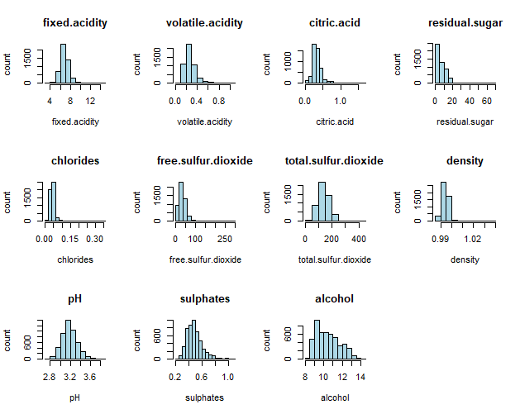
Histogram (Pre-cleaning)

Slide 7
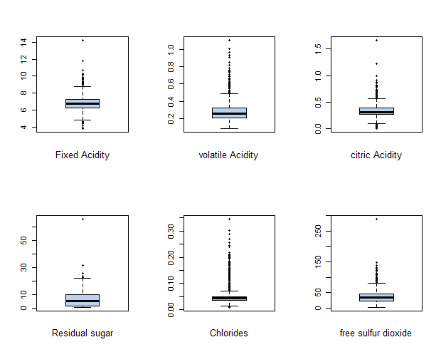
Box Plot (Before Cleaning)

Slide 8
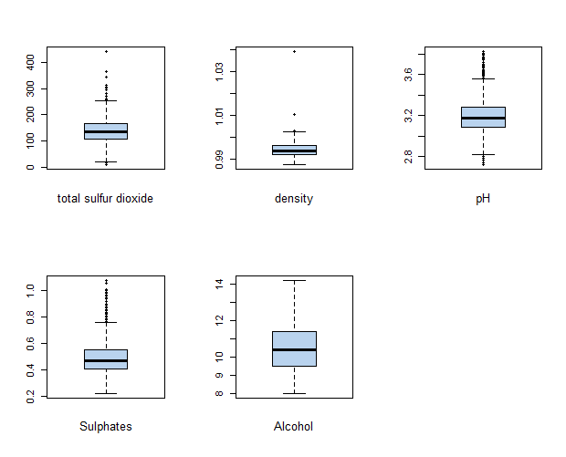
Boxplot (Before Cleaning)

Slide 9
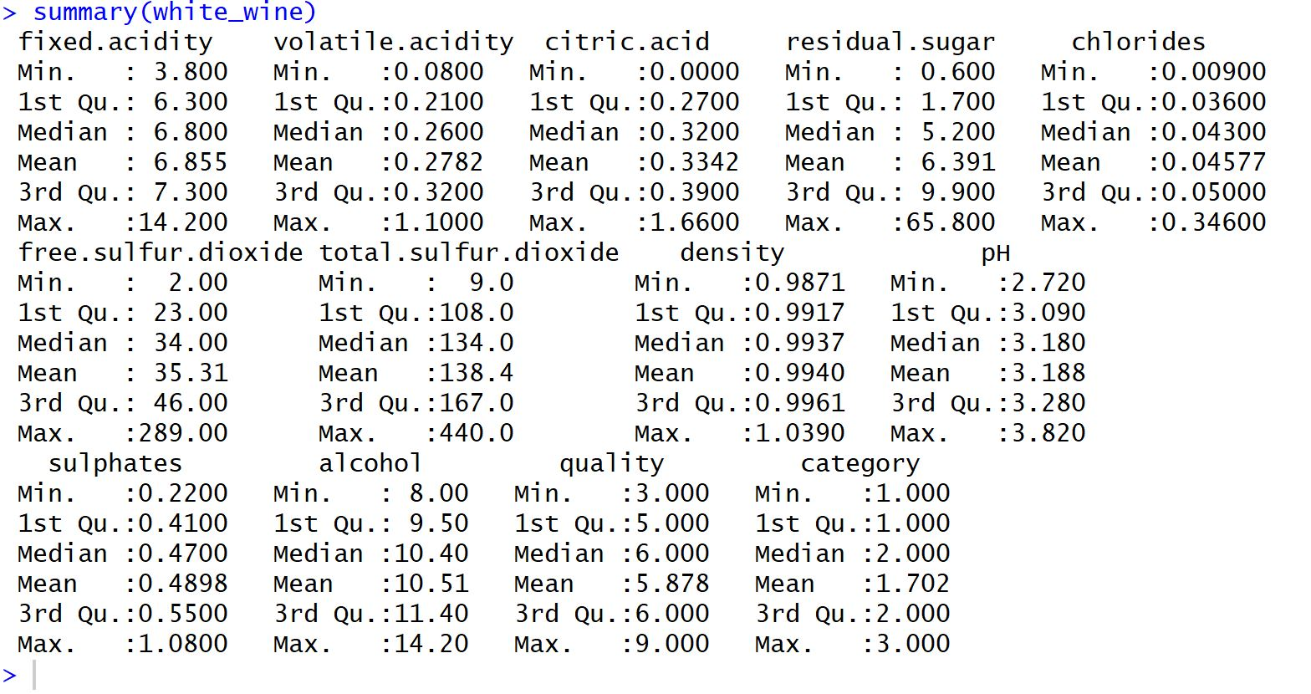
Q3 + (1.5 * IQR)

Slide 10
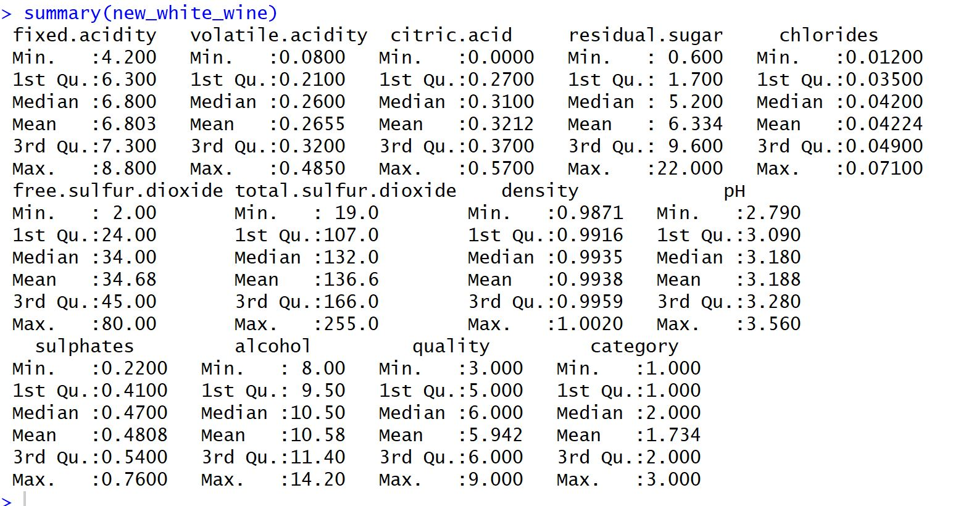

Slide 11
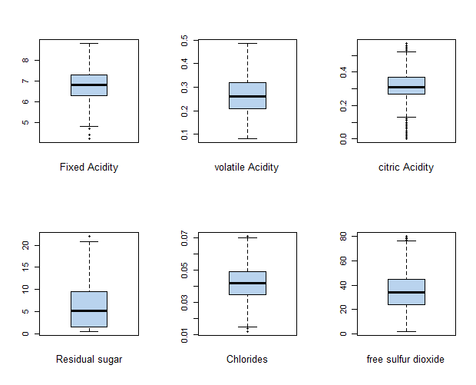
Boxplot (After Cleaning)

Slide 12
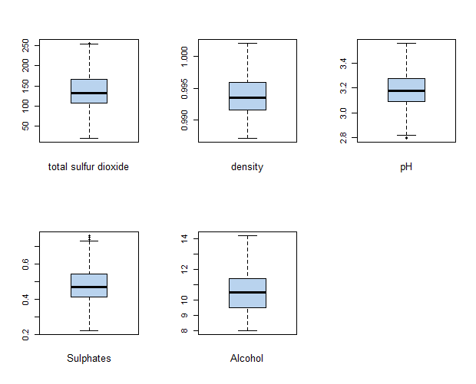
Boxplot (After Cleaning)

Slide 13
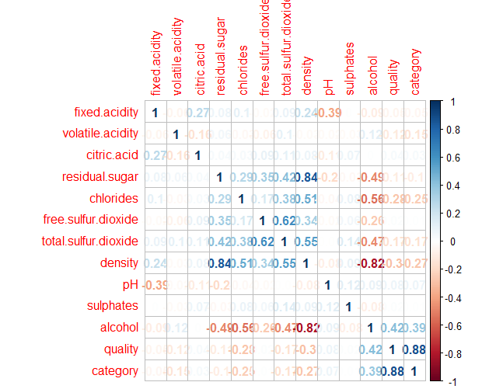
Correlation plot

Slide 14
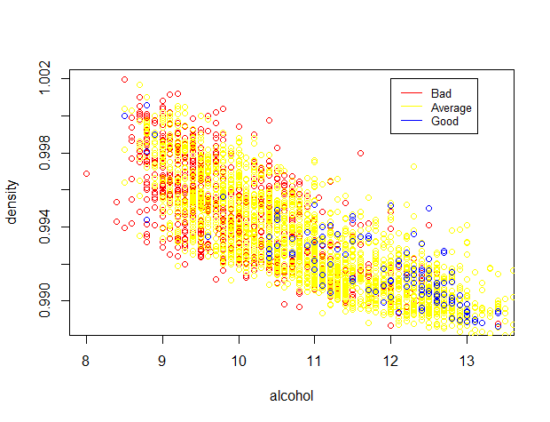
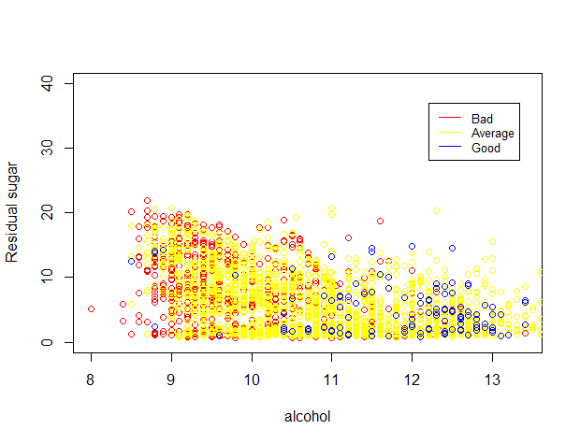
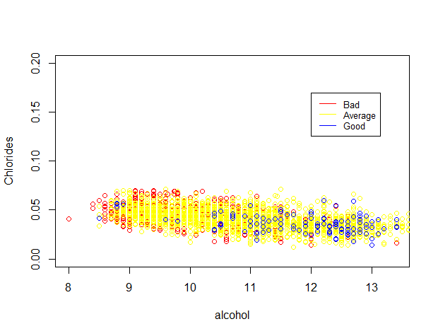
Alcohol vs Density
Alcohol vs Residual Sugar
Alcohol vs Chlorides

Slide 15
Correlation plot

Slide 16
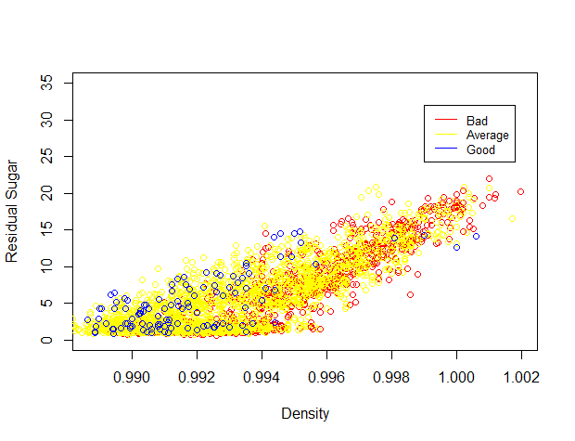
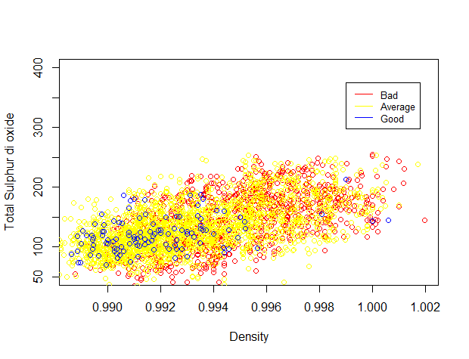
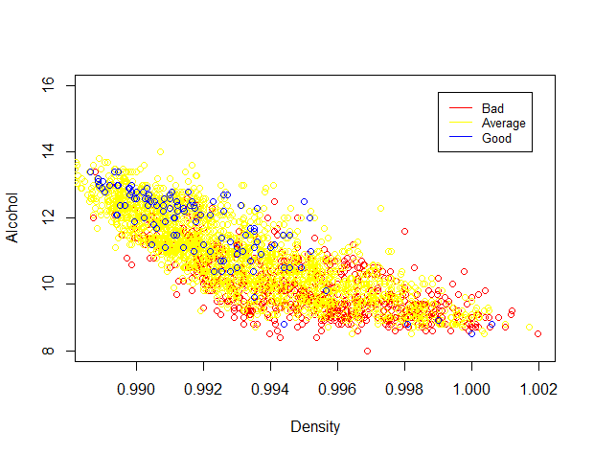
Density vs Residual Sugar
Density vs Total Sulphur Dioxide
Density vs Alcohol

Slide 17
Top Features Selected
Based on the correlation the top five features are :
Volatile acidity
Chlorides
Total Sulfur dioxide
Alcohol
Density
Datasets used
Top 5 features
All features

Slide 18
Classifications used
We have used the following Classifications:
KNN
C50
ANN
Naïve Bayes
Random Forest

Slide 19
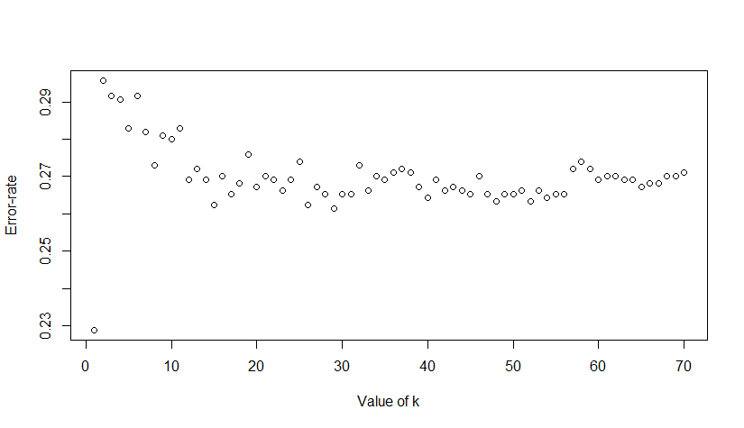
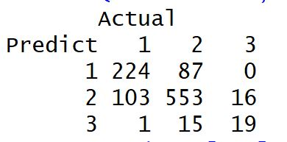
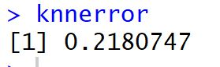
KNN for all features
Determining K Value
For K=1

Slide 20
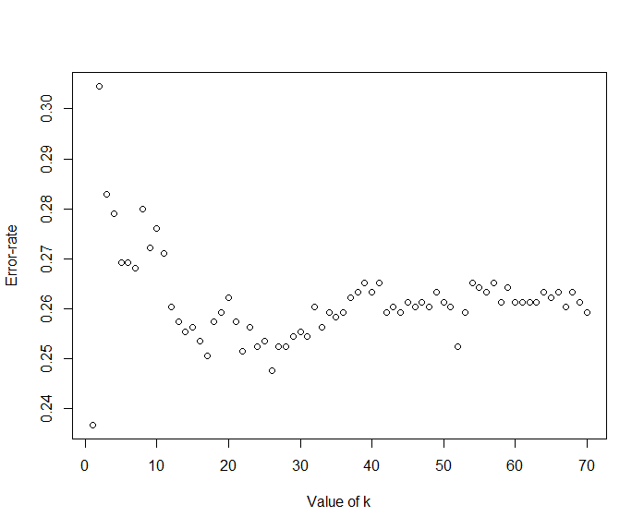
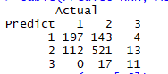
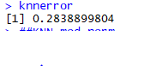
KNN for Selected Features
Determining K Value
For K=1

Slide 21
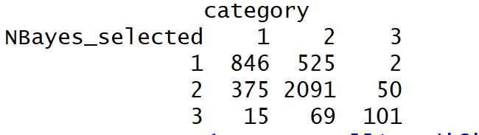
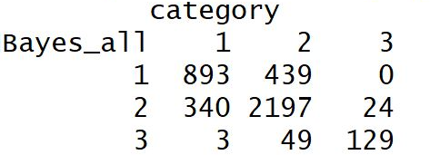
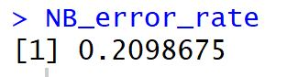
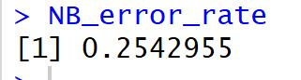
Naïve Bayes
All Features
Selected Features

Slide 22
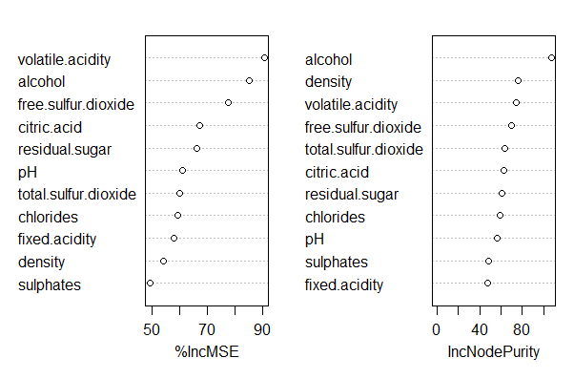
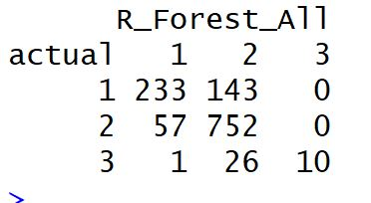
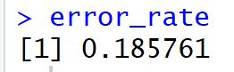
Random Forest for All features

Slide 23
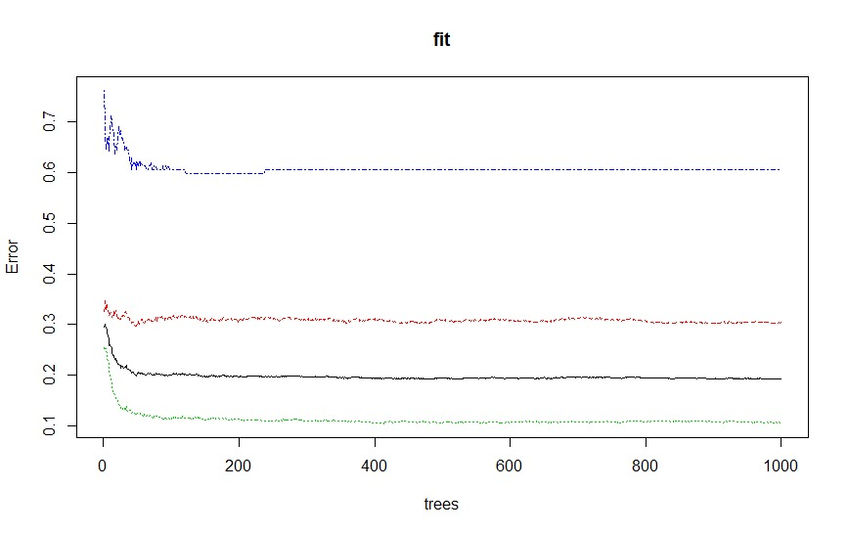
All features in RF

Slide 24
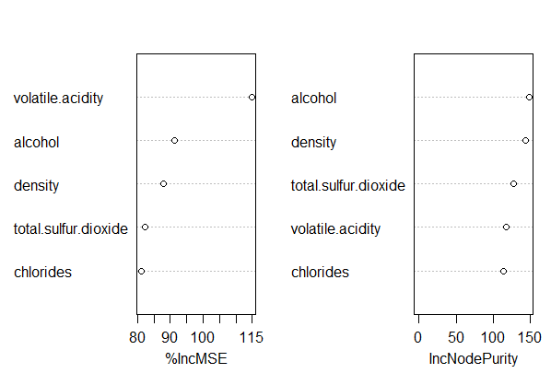
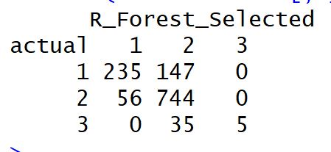
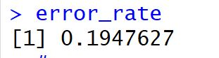
Random Forest for Selected Features

Slide 25
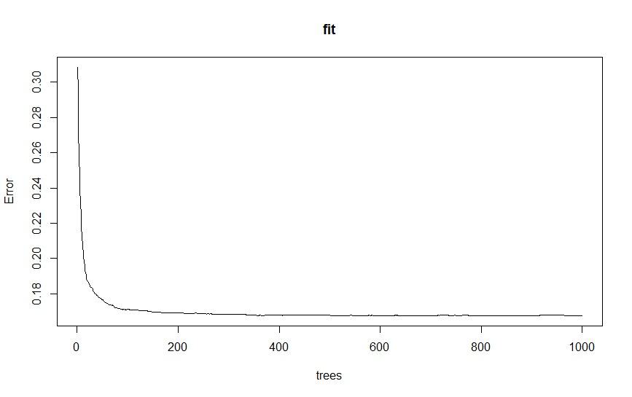
Selected features in RF

Slide 26
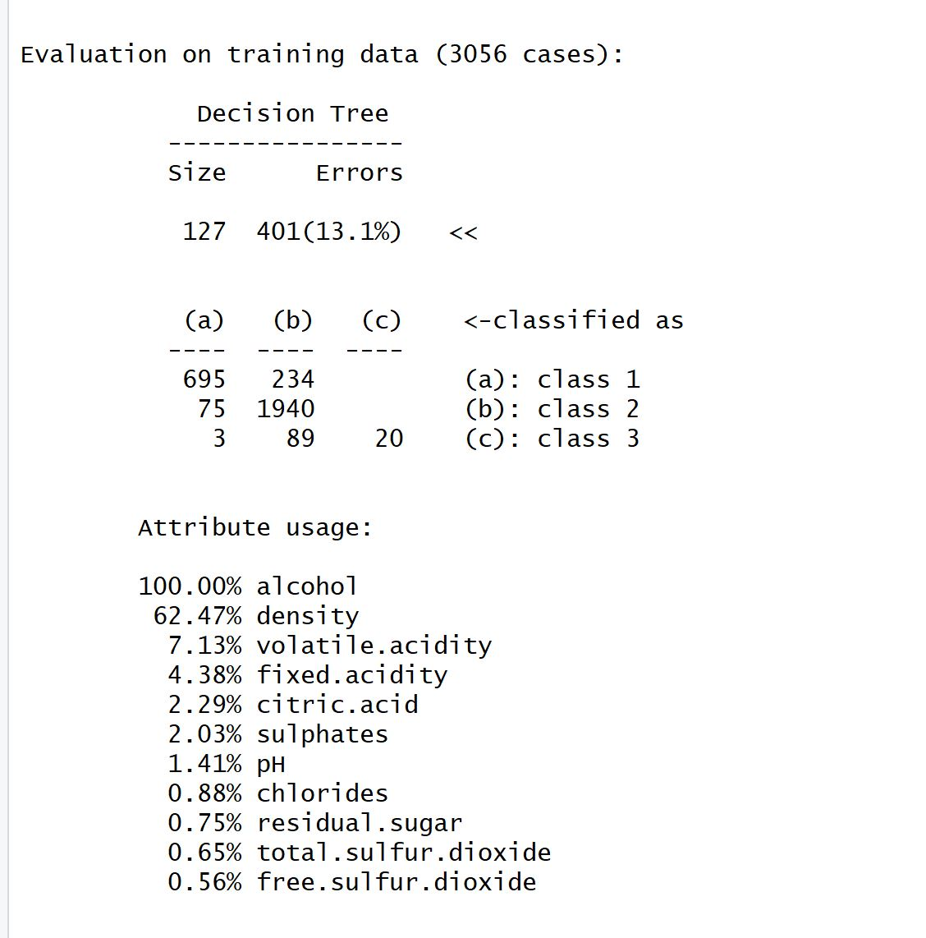
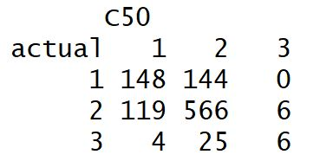
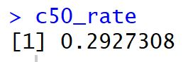
C50 Classification
All Features

Slide 27
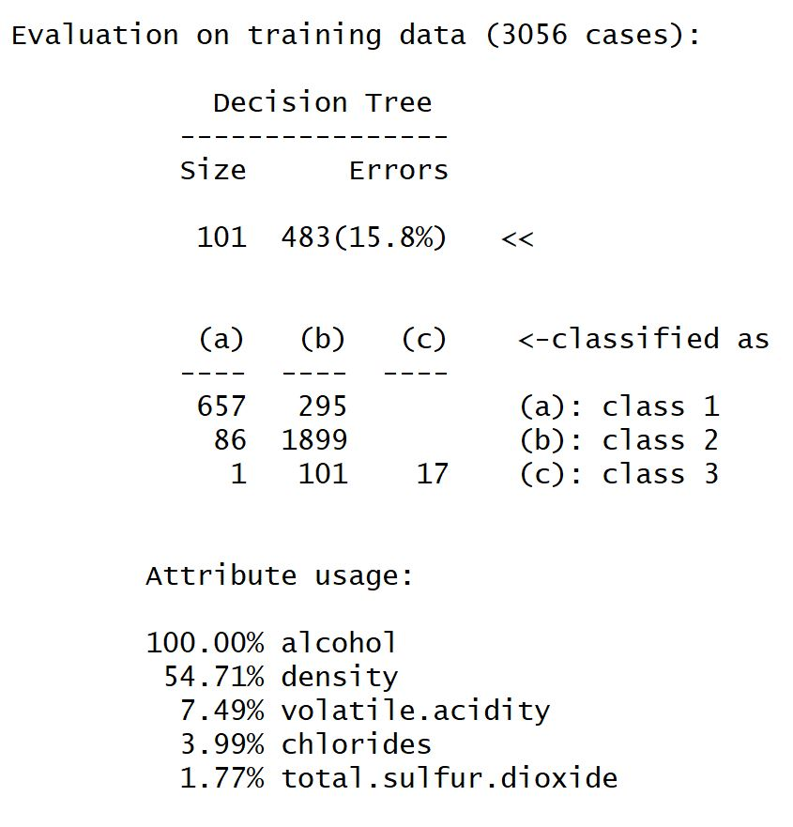
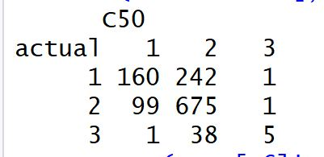
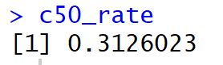
C50 Classification
Selected Features

Slide 28
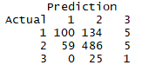
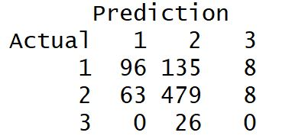
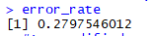
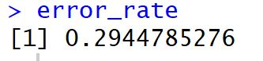
ANN Classification
All Features
Selected Features

Slide 29
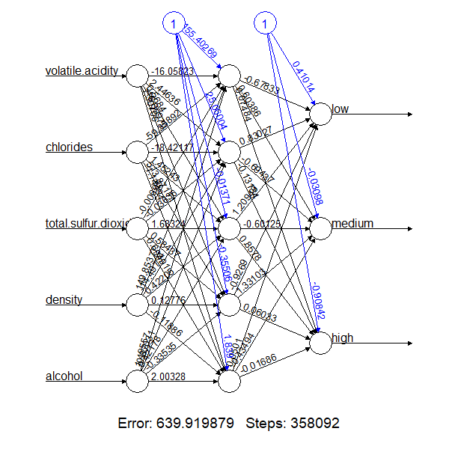
ANN Graph

Slide 30
Summary
Random forest gives best result while prediction
Naïve Bayes will suit this data better
All features give better results everytime.
Alcohol accounts for about 20% variance of quality
Density for 10% variance of quality
Other attributes do not correlate to quality significantly.

Slide 31
R code
#clear all the variables in the environmentrm(list = ls())#install the required packagesinstall.packages("ISLR")##install.packages("caret")install.packages("leaps")#call the required packageslibrary(ISLR)library(class)#library(caret)library(leaps)install.packages("corrplot")library(corrplot)install.packages("car")library(car)install.packages("e1071")require(e1071)#install.packages("bootstrap")#library(bootstrap)library(rpart)install.packages("gbm")library(gbm)white_wine<- read.csv("C://Users/Sharan Jotwani/Documents/CS513/winequality-white.csv")# test_wine<-# read.csv("C://Users/Sharan Jotwani/Documents/CS513/test_wine.csv")##food <- factor(food, levels=c("low", "medium", "high"), ordered=TRUE)##white_wine <- as.data.frame(white_wine)##white_wine$category[white_wine$category=='Low'] <- '1'white_wine_factor<-factor(white_wine$category,levels=c("Low", "Medium", "High"), ordered=TRUE)white_wine$category<-as.integer(white_wine_factor)#white_wine <- as.data.frame(white_wine)#View(white_wine)#can be reffered directly#attach(white_wine)summary(white_wine)summary(quality)#typeof(fixed_acidity)#summary(fixed_acidity)#?lapply()white_wine = data.frame(lapply(white_wine, function(x) as.numeric(as.character(x))))#typeof(fixed_acidity)#View(white_wine)############################################################################################# Histogram for quality############################################################################################hist(white_wine$category, main = "Histogram for category", xlab = "category", ylab = "count", col = "lightblue");############################################################################################# Histogram for all predictors############################################################################################?par()par(mfrow = c(3,4))hist(white_wine$fixed.acidity, main = "fixed.acidity", xlab = "fixed.acidity", ylab = "count", col = "lightblue");hist(white_wine$volatile.acidity, main = "volatile.acidity", xlab = "volatile.acidity", ylab = "count", col = "lightblue");hist(white_wine$citric.acid, main = "citric.acid", xlab = "citric.acid", ylab = "count", col = "lightblue");hist(white_wine$residual.sugar, main = "residual.sugar", xlab = "residual.sugar", ylab = "count", col = "lightblue");hist(white_wine$chlorides, main = "chlorides", xlab = "chlorides", ylab = "count", col = "lightblue");hist(white_wine$free.sulfur.dioxide, main = "free.sulfur.dioxide", xlab = "free.sulfur.dioxide", ylab = "count", col = "lightblue");hist(white_wine$total.sulfur.dioxide, main = "total.sulfur.dioxide", xlab = "total.sulfur.dioxide", ylab = "count", col = "lightblue");hist(white_wine$density, main = "density", xlab = "density", ylab = "count", col = "lightblue");hist(white_wine$pH, main = "pH", xlab = "pH", ylab = "count", col = "lightblue");hist(white_wine$sulphates, main = "sulphates", xlab = "sulphates", ylab = "count", col = "lightblue");hist(white_wine$alcohol, main = "alcohol", xlab = "alcohol", ylab = "count", col = "lightblue");
############################################################################################## Box plot to check outliers############################################################################################# Box plot before removing outliers############################################################################################par(mfrow = c(1,1))#boxplot(fixed.acidity)boxplot(white_wine$fixed.acidity, horizontal = FALSE, col="slategray2", pch=19)mtext("Fixed Acidity", cex=0.8, side=1, line=2)boxplot(white_wine$volatile.acidity, horizontal = FALSE, col="slategray2", pch=19)mtext("volatile Acidity", cex=0.8, side=1, line=2)boxplot(white_wine$citric.acid, horizontal = FALSE, col="slategray2", pch=19)mtext("citric Acidity", cex=0.8, side=1, line=2)boxplot(white_wine$residual.sugar, horizontal = FALSE, col="slategray2", pch=19)mtext("Residual sugar", cex=0.8, side=1, line=2)boxplot(white_wine$chlorides, horizontal = FALSE, col="slategray2", pch=19)mtext("Chlorides", cex=0.8, side=1, line=2)boxplot(white_wine$free.sulfur.dioxide, horizontal = FALSE, col="slategray2", pch=19)mtext("free sulfur dioxide", cex=0.8, side=1, line=2)boxplot(white_wine$total.sulfur.dioxide,horizontal = FALSE, col="slategray2", pch=19)mtext("total sulfur dioxide", cex=0.8, side=1, line=2)boxplot(white_wine$density,horizontal = FALSE, col="slategray2", pch=19)mtext("density", cex=0.8, side=1, line=2)boxplot(white_wine$pH, horizontal = FALSE, col="slategray2", pch=19)mtext("pH", cex=0.8, side=1, line=2)boxplot(white_wine$sulphates,horizontal = FALSE, col="slategray2", pch=19)mtext("Sulphates", cex=0.8, side=1, line=2)boxplot(white_wine$alcohol,horizontal = FALSE, col="slategray2", pch=19)mtext("Alcohol", cex=0.8, side=1, line=2)###########################################################################################?cor()cor_white_wine = cor(white_wine)cor_white_winepar(mfrow =c(1,1))corrplot(cor_white_wine, method = "number")# Removing the outliers###########################################################################################outliers = rep(0,11)for (i in 1:11){ t1 <- quantile(white_wine[,i], 0.75) t2 <- IQR(white_wine[,i], 0.75) outliers[i] <- t1 + 1.5*t2}white_wine_index = matrix(0, 4898, 11)for (i in 1:4898) for (j in 1:11){ if (white_wine[i,j] > outliers[j]) white_wine_index[i,j] = 1 }w_index = apply(white_wine_index, 1, sum)white_wine_data = cbind(w_index, white_wine)index = rep(0)j = 1for (i in 1:4898){ if (w_index[i] > 0) {index[j]= i j = j + 1} else j = j}new_white_wine = white_wine[-index,]#After removing outliers, we get 4074 observationsnrow(new_white_wine)summary(new_white_wine)?cor()cor_white_wine = cor(new_white_wine)cor_white_winepar(mfrow =c(1,1))corrplot(cor_white_wine, method = "number")

Slide 32
par(mfrow = c(2,3))#boxplot(fixed.acidity)boxplot(new_white_wine$fixed.acidity, horizontal = FALSE, col="slategray2", pch=19)mtext("Fixed Acidity", cex=0.8, side=1, line=2)boxplot(new_white_wine$volatile.acidity, horizontal = FALSE, col="slategray2", pch=19)mtext("volatile Acidity", cex=0.8, side=1, line=2)boxplot(new_white_wine$citric.acid, horizontal = FALSE, col="slategray2", pch=19)mtext("citric Acidity", cex=0.8, side=1, line=2)boxplot(new_white_wine$residual.sugar, horizontal = FALSE, col="slategray2", pch=19)mtext("Residual sugar", cex=0.8, side=1, line=2)boxplot(new_white_wine$chlorides, horizontal = FALSE, col="slategray2", pch=19)mtext("Chlorides", cex=0.8, side=1, line=2)boxplot(new_white_wine$free.sulfur.dioxide, horizontal = FALSE, col="slategray2", pch=19)mtext("free sulfur dioxide", cex=0.8, side=1, line=2)boxplot(new_white_wine$total.sulfur.dioxide,horizontal = FALSE, col="slategray2", pch=19)mtext("total sulfur dioxide", cex=0.8, side=1, line=2)boxplot(new_white_wine$density,horizontal = FALSE, col="slategray2", pch=19)mtext("density", cex=0.8, side=1, line=2)boxplot(new_white_wine$pH, horizontal = FALSE, col="slategray2", pch=19)mtext("pH", cex=0.8, side=1, line=2)boxplot(new_white_wine$sulphates,horizontal = FALSE, col="slategray2", pch=19)mtext("Sulphates", cex=0.8, side=1, line=2)boxplot(new_white_wine$alcohol,horizontal = FALSE, col="slategray2", pch=19)mtext("Alcohol", cex=0.8, side=1, line=2)##############################DATA CLEANING##############################################################################DATA CLEANING################################################?plot()bad<-new_white_wine[new_white_wine$category==1,]average<-new_white_wine[new_white_wine$category==2,]good<-new_white_wine[new_white_wine$category==3,]plot(bad$alcohol,average$alcohol,good$alcohol,xlim=c(1, max(length(bad$alcohol), length(average$alcohol), length(good$alcohol))),ylim=c(1, max(length(bad$alcohol), length(average$alcohol), length(good$alcohol))))plot(x=good[,1])plot(good$alcohol,col="blue",ylab="alcohol")points(bad$alcohol, col="red")points(average$alcohol, col="yellow")plot(good$density,col="blue", ylab="density")points(bad$density, col="red")points(average$density, col="yellow")##ALCOHOL DENSITYplot(bad$alcohol,bad$density, col="red", xlab = "alcohol", ylab="density")points(average$alcohol,average$density, col="yellow")points(good$alcohol,good$density,col="blue")legend(12, 1.002, legend=c("Bad", "Average","Good"), col=c("red", "yellow","blue"), lty=1:1,cex=0.8)#Alc RSplot(bad$alcohol,bad$residual.sugar, col="red", xlab = "alcohol", ylab="Residual sugar",ylim = c(0,40))points(average$alcohol,average$residual.sugar, col="yellow")points(good$alcohol,good$residual.sugar,col="blue")legend(12.2, 37, legend=c("Bad", "Average","Good"), col=c("red", "yellow","blue"), lty=1:1,cex=0.8)
#Alc chloridesplot(bad$alcohol,bad$chlorides, col="red", xlab = "alcohol", ylab="Chlorides",ylim = c(0,0.2))points(average$alcohol,average$chlorides, col="yellow")points(good$alcohol,good$chlorides,col="blue")legend(12, 0.17, legend=c("Bad", "Average","Good"), col=c("red", "yellow","blue"), lty=1:1,cex=0.8)#Density alcoholplot(bad$density,bad$alcohol, col="red", xlab = "Density", ylab="Alcohol", ylim=c(8,16))points(average$density,average$alcohol, col="yellow")points(good$density,good$alcohol,col="blue")legend(0.999, 15.8, legend=c("Bad", "Average","Good"), col=c("red", "yellow","blue"), lty=1:1,cex=0.8)##Density RSplot(bad$density,bad$residual.sugar, col="red", xlab = "Density", ylab="Residual Sugar",ylim=c(0,35))points(average$density,average$residual.sugar, col="yellow")points(good$density,good$residual.sugar,col="blue")legend(0.999, 32, legend=c("Bad", "Average","Good"), col=c("red", "yellow","blue"), lty=1:1,cex=0.8)#Density TSDplot(bad$density,bad$total.sulfur.dioxide, col="red", xlab = "Density", ylab="Total Sulphur di oxide", ylim=c(50,400))points(average$density,average$total.sulfur.dioxide, col="yellow")points(good$density,good$total.sulfur.dioxide,col="blue")legend(0.999, 375, legend=c("Bad", "Average","Good"), col=c("red", "yellow","blue"), lty=1:1,cex=0.8)?plot()?legend()d<-density(good$alcohol)plot(d)# summary(good)# great<-white_wine[white_wine$category==3,]# summary(great)# ####### KNN <- knn(new_white_wine[,-c(12,13)],test_wine[,-c(12,13)],new_white_wine[,13],k=1)# table(Predict=KNN, Actual=test_wine[,13])# wrong<- (test_wine[,13]!=KNN)# knnerror<-sum(wrong)/length(test_wine[,13]) #10# knnerror##KNN normmmnorm <- function(x,minx,maxx){ z<-((x-minx)/(maxx-minx)) return(z)}wine_normalized<-as.data.frame( cbind( fixed.acidity=mmnorm(new_white_wine[,1],min(new_white_wine[,1]),max(new_white_wine[,1])) ,volatile.acidity=mmnorm(new_white_wine[,2],min(new_white_wine[,2]),max(new_white_wine[,2])) ,citric.acid=mmnorm(new_white_wine[,3],min(new_white_wine[,3]),max(new_white_wine[,3])),residual.sugar=mmnorm(new_white_wine[,4],min(new_white_wine[,4]),max(new_white_wine[,4])) ,chlorides=mmnorm(new_white_wine[,5],min(new_white_wine[,5]),max(new_white_wine[,5])),free.sulfur.dioxide=mmnorm(new_white_wine[,6],min(new_white_wine[,6]),max(new_white_wine[,6])) ,total.sulfur.dioxide=mmnorm(new_white_wine[,7],min(new_white_wine[,7]),max(new_white_wine[,7])),density=mmnorm(new_white_wine[,8],min(new_white_wine[,8]),max(new_white_wine[,8])),pH=mmnorm(new_white_wine[,9],min(new_white_wine[,9]),max(new_white_wine[,9])),sulphates=mmnorm(new_white_wine[,10],min(new_white_wine[,10]),max(new_white_wine[,10])) ,alcohol=mmnorm(new_white_wine[,11],min(new_white_wine[,11]),max(new_white_wine[,11])) ,category=new_white_wine[,13] ))

Slide 33
library(class)indexknn<-sort(sample(nrow(wine_normalized),round(.25*nrow(wine_normalized))))training<-wine_normalized[-indexknn,]test<-wine_normalized[indexknn,]vec <- vector(mode="numeric", length=50)vec2<- vector(mode="numeric",length=50)for(i in c(1:50)){ predict<-knn(training[,-12],test[,-12],training[,12],k=i) wrong<-(test[,12]!=predict) rate<-sum(wrong)/length(wrong) print(rate) vec[i]=rate vec2[i]=i}plot(vec2,vec,xlab="Value of k", ylab="Error-rate")indexknn<-sort(sample(nrow(wine_normalized),round(.25*nrow(wine_normalized))))training<-wine_normalized[-indexknn,]test<-wine_normalized[indexknn,]KNN <- knn(training[,-12],test[,-12],training[,12],k=1)table(Predict=KNN, Actual=test[,12])wrong<- (test[,12]!=KNN)knnerror<-sum(wrong)/length(test[,12]) #10knnerror##KNN not normlibrary(class)indexknn<-sort(sample(nrow(new_white_wine),round(.25*nrow(new_white_wine))))training<-new_white_wine[-indexknn,]test<-new_white_wine[indexknn,]KNN <- knn(training[,-c(12,13)],test[,-c(12,13)],training[,13],k=1)table(Predict=KNN, Actual=test[,13])wrong<- (test[,13]!=KNN)knnerror<-sum(wrong)/length(test[,13]) #10knnerror#####new_white_wine_factor<-new_white_winenew_white_wine_factor$fixed.acidity<-as.factor(new_white_wine_factor$fixed.acidity)new_white_wine_factor$volatile.acidity<-as.factor(new_white_wine_factor$volatile.acidity)new_white_wine_factor$citric.acid<-as.factor(new_white_wine_factor$citric.acid)new_white_wine_factor$residual.sugar<-as.factor(new_white_wine_factor$residual.sugar)new_white_wine_factor$chlorides<-as.factor(new_white_wine_factor$chlorides)new_white_wine_factor$free.sulfur.dioxide<-as.factor(new_white_wine_factor$free.sulfur.dioxide)new_white_wine_factor$total.sulfur.dioxide<-as.factor(new_white_wine_factor$total.sulfur.dioxide)new_white_wine_factor$density<-as.factor(new_white_wine_factor$density)new_white_wine_factor$pH<-as.factor(new_white_wine_factor$pH)new_white_wine_factor$sulphates<-as.factor(new_white_wine_factor$sulphates)new_white_wine_factor$alcohol<-as.factor(new_white_wine_factor$alcohol)new_white_wine_factor$category<-as.factor(new_white_wine_factor$category)##new_white_wine_factor$fixed.acidity<-as.factor(new_white_wine_factor$fixed.acidity)####NBlibrary(class) library(e1071)nBayes_all <- naiveBayes(category~fixed.acidity+volatile.acidity+citric.acid+residual.sugar+chlorides+free.sulfur.dioxide+total.sulfur.dioxide+density+pH+sulphates+alcohol,data=new_white_wine_factor)category_all<-predict(nBayes_all,new_white_wine_factor)table(NBayes_all=category_all,category = new_white_wine_factor$category)NB_wrong<-sum(category_all!=new_white_wine_factor$category)NB_error_rate<-NB_wrong/length(category_all)NB_error_rate###RFnew_white_wine_numeric <- new_white_winenew_white_wine_numeric$fixed.acidity<-as.numeric(new_white_wine_numeric$fixed.acidity)new_white_wine_numeric$volatile.aci
dity<-as.numeric(new_white_wine_numeric$volatile.acidity)new_white_wine_numeric$citric.acid<-as.numeric(new_white_wine_numeric$citric.acid)new_white_wine_numeric$residual.sugar<-as.numeric(new_white_wine_numeric$residual.sugar)new_white_wine_numeric$chlorides<-as.numeric(new_white_wine_numeric$chlorides)new_white_wine_numeric$free.sulfur.dioxide<-as.numeric(new_white_wine_numeric$free.sulfur.dioxide)new_white_wine_numeric$total.sulfur.dioxide<-as.numeric(new_white_wine_numeric$total.sulfur.dioxide)new_white_wine_numeric$density<-as.numeric(new_white_wine_numeric$density)new_white_wine_numeric$pH<-as.numeric(new_white_wine_numeric$pH)new_white_wine_numeric$sulphates<-as.numeric(new_white_wine_numeric$sulphates)new_white_wine_numeric$alcohol<-as.numeric(new_white_wine_numeric$alcohol)new_white_wine_numeric$category<-as.numeric(new_white_wine_numeric$category)indexrf<-sort(sample(nrow(new_white_wine_numeric),round(.3*nrow(new_white_wine_numeric))))trainingrf <-new_white_wine_numeric[-indexrf,]testrf <-new_white_wine_numeric[indexrf,]##indexrf##View(trainingrf)library(randomForest)fit <- randomForest(category~fixed.acidity+volatile.acidity+citric.acid+residual.sugar+chlorides+free.sulfur.dioxide+total.sulfur.dioxide+density+pH+sulphates+alcohol, data=trainingrf, importance=TRUE, ntree=1000)importance(fit)varImpPlot(fit)Prediction <- predict(fit, testrf)PredictionPrediction<-round(Prediction)table(actual=testrf[,13],R_Forest_All=Prediction)#a<-testrf[,13]wrong<- (testrf[,13]!=Prediction )error_rate<-sum(wrong)/length(wrong)error_rate #wrong#C50index<-sort(sample(nrow(new_white_wine_factor),round(.25*nrow(new_white_wine_factor))))training<-new_white_wine_factor[-index,]test<-new_white_wine_factor[index,]# C50 classification library('C50')C50_class <- C5.0(category~fixed.acidity+volatile.acidity+citric.acid+residual.sugar+chlorides+free.sulfur.dioxide+total.sulfur.dioxide+density+pH+sulphates+alcohol, data=training )summary(C50_class )#dev.off()plot(C50_class)C50_predict<-predict( C50_class ,test , type="class" )table(actual=test[,13],C50=C50_predict)wrong<- (test[,13]!=C50_predict)c50_rate<-sum(wrong)/length(test[,13])c50_rate#######ANN##ANN##using densitylow<-ifelse(new_white_wine$category==1,1,0)medium<-ifelse(new_white_wine$category==2,1,0)high<-ifelse(new_white_wine$category==3,1,0)new_white_wine_ann<- data.frame(new_white_wine,low,medium,high)index <- seq (1,nrow(new_white_wine_ann),by=5)test<-new_white_wine_ann[index,]training<-new_white_wine_ann[-index,]install.packages("neuralnet")library("neuralnet")?neuralnet()

Slide 34
net_new_white_wine <- neuralnet(low+medium+high~fixed.acidity+volatile.acidity+citric.acid+residual.sugar+chlorides+free.sulfur.dioxide+total.sulfur.dioxide+density+pH+sulphates+alcohol ,training, hidden=5, threshold=0.05)#Plot the neural networkplot(net_new_white_wine)net_new_white_wine_results <-compute(net_new_white_wine, test[,-c(12,13,14,15,16)]) class(net_new_white_wine_results$net.result)abc<-net_new_white_wine_results$net.result#str(net_bc2_results)results<-data.frame(Actual_low=test$low, Actual_medium=test$medium, Actual_high=test$high, ANN_low=round(net_new_white_wine_results$net.result[,1]), ANN_medium=round(net_new_white_wine_results$net.result[,2]), ANN_high=round(net_new_white_wine_results$net.result[,3]))results2<-data.frame(Actual_low=test$low, Actual_medium=test$medium, Actual_high=test$high, ANN_low=round(net_new_white_wine_results$net.result[,1]), ANN_medium=round(net_new_white_wine_results$net.result[,2]), ANN_high=round(net_new_white_wine_results$net.result[,3]), Prediction = ifelse(round(net_new_white_wine_results$net.result[,1])==1,1 ,ifelse(round(net_new_white_wine_results$net.result[,2])==1,2,3)))table(Actual=test$category,Prediction=results2$Prediction)wrong<- (results2$Prediction!=test$category )error_rate<-sum(wrong)/length(wrong)error_rate######################################################################################test<-new_white_wine[new_white_wine$category==1,]mean(test$total.sulfur.dioxide)# boxplot(new_white_wine$fixed.acidity)# plot(new_white_wine[,c(13,1)])par(mfrow = c(1,3))boxplot(fixed.acidity~category,data=new_white_wine, main="Fixed Acidity", xlab="Category", ylab="Fixed Acidity")boxplot(volatile.acidity~category,data=new_white_wine, main="Volatile Acidity", xlab="Category", ylab="Volatile Acidity")boxplot(citric.acid~category,data=new_white_wine, main="Citric Acid", xlab="Category", ylab="Citric Acid")boxplot(residual.sugar~category,data=new_white_wine, main="Residual Sugar", xlab="Category", ylab="Residual Sugar")boxplot(chlorides~category,data=new_white_wine, main="Chlorides", xlab="Category", ylab="Chlorides")boxplot(free.sulfur.dioxide~category,data=new_white_wine, main="Free Sulphur dioxide", xlab="Category", ylab="Free Sulphur dioxide")boxplot(total.sulfur.dioxide~category,data=new_white_wine, main="Total Sulphur dioxide", xlab="Category", ylab="Total Sulphur dioxide")boxplot(density~category,data=new_white_wine, main="Density", xlab="Category", ylab="Density")boxplot(pH~category,data=new_white_wine, main="pH", xlab="Category", ylab="pH")boxplot(sulphates~category,data=new_white_wine,
main="Sulphates", xlab="Category", ylab="Sulphates")boxplot(alcohol~category,data=new_white_wine, main="Alcohol", xlab="Category", ylab="Alcohol")#################################################################################################MODIIFIEDmodified<-new_white_wine[,c(2,5,7,8,11,13)]#KNN modindexknn<-sort(sample(nrow(modified),round(.25*nrow(modified))))training<-modified[-indexknn,]test<-modified[indexknn,]KNN <- knn(training[,-6],test[,-6],training[,6],k=1)table(Predict=KNN, Actual=test[,6])wrong<- (test[,6]!=KNN)knnerror<-sum(wrong)/length(test[,6]) #10knnerror##KNN mod normmmnorm <- function(x,minx,maxx){ z<-((x-minx)/(maxx-minx)) return(z)}modified_normalized<-as.data.frame( cbind( volatile.acidity=mmnorm(modified[,1],min(modified[,1]),max(modified[,1])) ,chlorides=mmnorm(modified[,2],min(modified[,2]),max(modified[,2])) ,density=mmnorm(modified[,3],min(modified[,3]),max(modified[,3])) ,total.sulfur.dioxide=mmnorm(modified[,4],min(modified[,4]),max(modified[,4])) ,alcohol=mmnorm(modified[,5],min(modified[,5]),max(modified[,5])) ,category=modified[,6] ))indexknn<-sort(sample(nrow(modified_normalized),round(.25*nrow(modified_normalized))))training<-modified_normalized[-indexknn,]test<-modified_normalized[indexknn,]vec <- vector(mode="numeric", length=70)vec2<- vector(mode="numeric",length=70)for(i in c(1:70)){ predict<-knn(training[,-6],test[,-6],training[,6],k=i) wrong<-(test[,6]!=predict) rate<-sum(wrong)/length(wrong) print(rate) vec[i]=rate vec2[i]=i}plot(vec2,vec,xlab="Value of k", ylab="Error-rate")KNN <- knn(training[,-6],test[,-6],training[,6],k=12)table(Predict=KNN, Actual=test[,6])wrong<- (test[,6]!=KNN)knnerror<-sum(wrong)/length(test[,6]) #10knnerror######modified_factor<-modifiedmodified_factor$volatile.acidity<-as.factor(modified_factor$volatile.acidity)modified_factor$chlorides<-as.factor(modified_factor$chlorides)modified_factor$total.sulfur.dioxide<-as.factor(modified_factor$total.sulfur.dioxide)modified_factor$alcohol<-as.factor(modified_factor$alcohol)modified_factor$density<-as.factor(modified_factor$density)modified_factor$category<-as.factor(modified_factor$category)##NB modnBayes_all <- naiveBayes(category~volatile.acidity+chlorides+total.sulfur.dioxide+density+alcohol,data=modified_factor)## Naive Bayes classification using all variables category_all<-predict(nBayes_all,modified_factor)table(NBayes_selected=category_all,category = modified_factor$category)NB_wrong<-sum(category_all!=modified_factor$category)NB_error_rate<-NB_wrong/length(category_all)NB_error_rate#RFmodified_numeric<-modifiedmodified_numeric$volatile.acidity<-as.numeric(modified_numeric$volatile.acidity)modified_numeric$chlorides<-as.numeric(modified_numeric$chlorides)modified_numeric$total.sulfur.dioxide<-

Slide 35
as.numeric(modified_numeric$total.sulfur.dioxide)modified_numeric$alcohol<-as.numeric(modified_numeric$alcohol)modified_numeric$density<-as.numeric(modified_numeric$density)modified_numeric$category<-as.numeric(modified_numeric$category)indexrf<-sort(sample(nrow(modified_numeric),round(.3*nrow(modified_numeric))))trainingrf <-modified_numeric[-indexrf,]testrf <-modified_numeric[indexrf,]data(modified_numeric)mt.rf <- randomForest(category~. ,data=modified_numeric,ntree=1000, keep.forest=FALSE, importance=TRUE)plot(mt.rf,log="y")varImpPlot(mt.rf)install.packages(cforest)cforest(category~., data = modified_numeric, controls = cforest(mtry=2,mincriterion=0)) ##indexrf##View(trainingrf)library(randomForest)fit <- randomForest(category~volatile.acidity+chlorides+total.sulfur.dioxide+density+alcohol, data=trainingrf, importance=TRUE, ntree=1000)importance(fit)varImpPlot(fit)Prediction <- predict(fit, testrf)PredictionPrediction<-round(Prediction)table(actual=testrf[,6],R_Forest_Selected=Prediction)#a<-testrf[,13]wrong<- (testrf[,6]!=Prediction )error_rate<-sum(wrong)/length(wrong)error_rate #wrong####C50 modindex<-sort(sample(nrow(modified_factor),round(.25*nrow(modified_factor))))training<-modified_factor[-index,]test<-modified_factor[index,]# C50 classification library('C50')C50_class <- C5.0(category~volatile.acidity+chlorides+total.sulfur.dioxide+density+alcohol, data=training )summary(C50_class )#dev.off()plot(C50_class)C50_predict<-predict( C50_class ,test , type="class" )table(actual=test[,6],C50=C50_predict)wrong<- (test[,6]!=C50_predict)c50_rate<-sum(wrong)/length(test[,6])c50_rate
#######################low<-ifelse(modified$category==1,1,0)medium<-ifelse(modified$category==2,1,0)high<-ifelse(modified$category==3,1,0)modified_ann<- data.frame(modified,low,medium,high)index <- seq (1,nrow(modified_ann),by=5)test<-modified_ann[index,]training<-modified_ann[-index,]install.packages("neuralnet")library("neuralnet")?neuralnet()net_modified <- neuralnet(low+medium+high~volatile.acidity+chlorides+total.sulfur.dioxide+density+alcohol ,training, hidden=5, threshold=0.05,stepmax = 1e6)#Plot the neural networkplot(net_modified)net_modified_results <-compute(net_modified, test[,-c(6,7,8,9)]) class(net_modified_results$net.result)abc<-net_modified_results$net.result#str(net_bc2_results)modified_results<-data.frame(Actual_low=test$low, Actual_medium=test$medium, Actual_high=test$high, ANN_low=round(net_modified_results$net.result[,1]), ANN_medium=round(net_modified_results$net.result[,2]), ANN_high=round(net_modified_results$net.result[,3]))results2<-data.frame(Actual_low=test$low, Actual_medium=test$medium,
Actual_high=test$high, ANN_low=round(net_modified_results$net.result[,1]), ANN_medium=round(net_modified_results$net.result[,2]), ANN_high=round(net_modified_results$net.result[,3]), Prediction = ifelse(round(net_modified_results$net.result[,1])==1,1 ,ifelse(round(net_modified_results$net.result[,2])==1,2,3)))table(Actual=test$category,Prediction=results2$Prediction)wrong<- (results2$Prediction!=test$category )error_rate<-sum(wrong)/length(wrong)error_rate

Slide 36
References:
Stack overflow
Lecture Notes
Data set taken from : https://www.kaggle.com/numberswithkartik/red-white-wine-dataset

Slide 37
Thank You

